Slide 1
Autonomous Car Model
Mansi Panchal (07617702018)
Prince Kumar (09117702018)

Slide 2
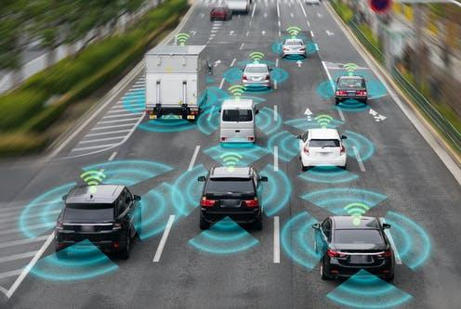
What do we mean by Autonomous car?
A self-driving car, also known as an autonomous vehicle, is a vehicle that is capable of sensing its environment and moving safely with little or no human input.
With this project, we propose Level 1 automation.

Slide 3
What technology did we use?
We will be able to autonomously control the steering wheel of the car and run it on a constant speed, such that the simulated car can run autonomously in a simulated environment, we will use the Open source Udacity self driving car simulator for that.
The machine learning model will be made using Convolutional neural networks in Tensorflow and Keras and a socket connection will be made between the Udacity simulator and the Tensorflow script.

Slide 4
Working Project
CNN model to socketio connection

Slide 5
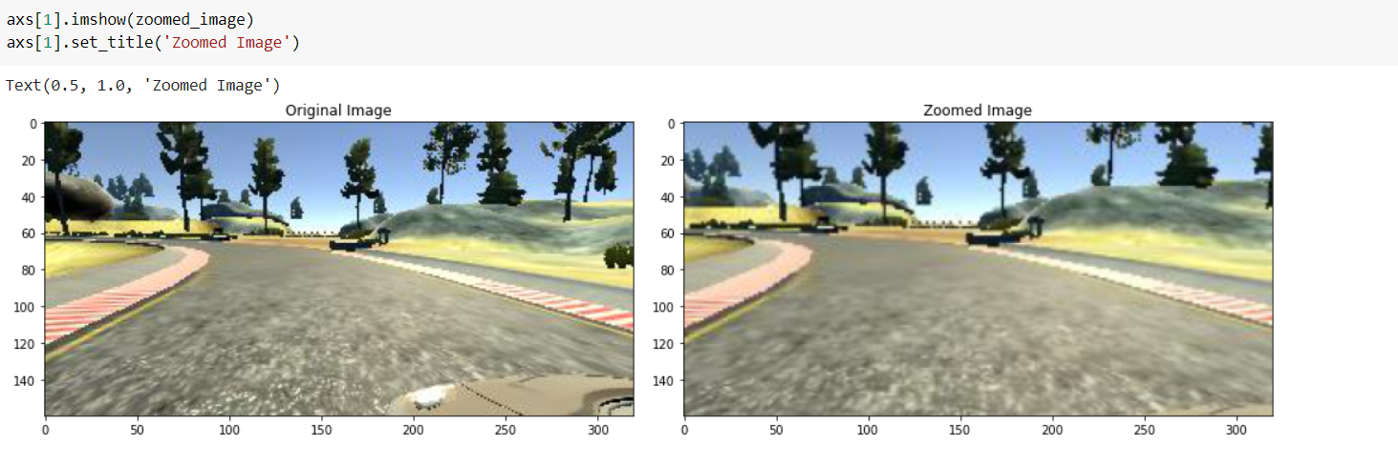
Setting up CNN Model

Slide 6
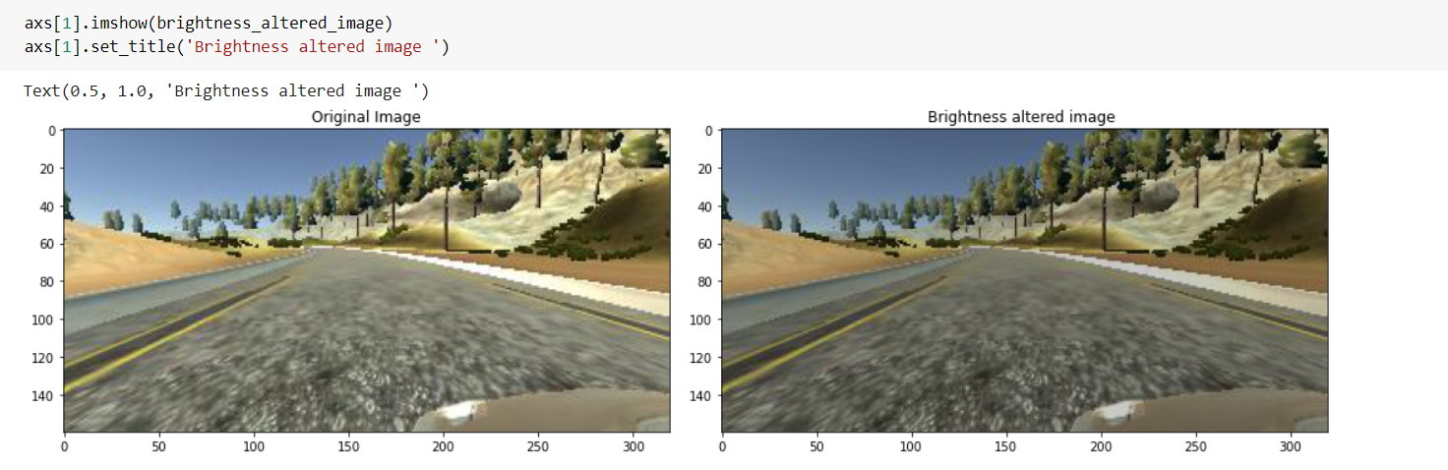
Setting up CNN Model

Slide 7
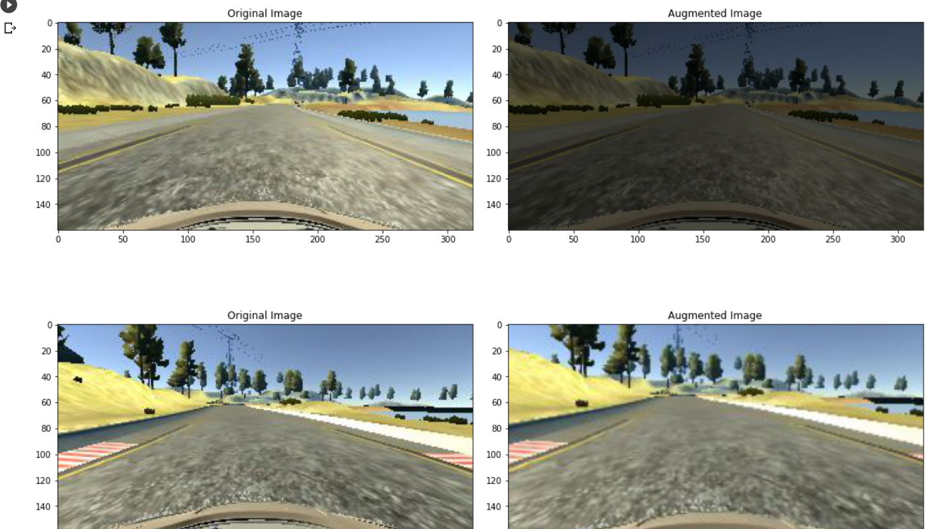
Setting up CNN Model

Slide 8
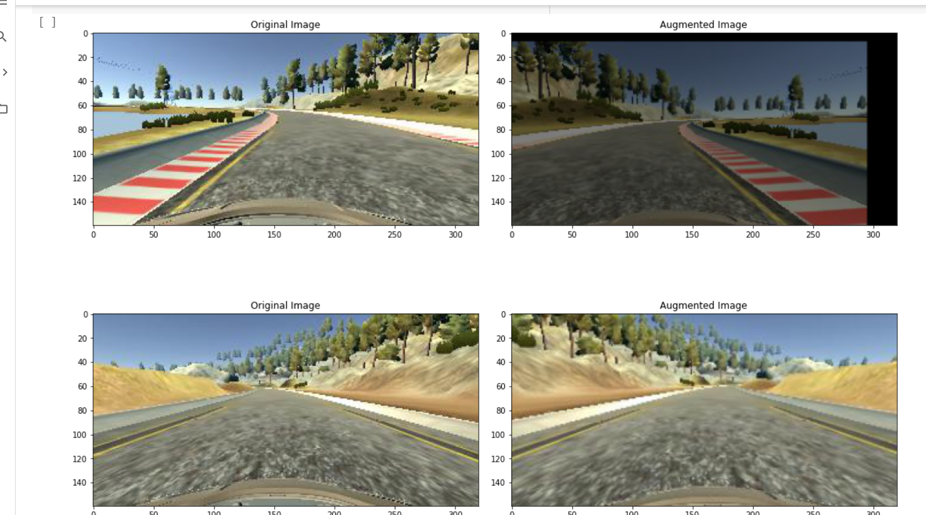

Slide 9
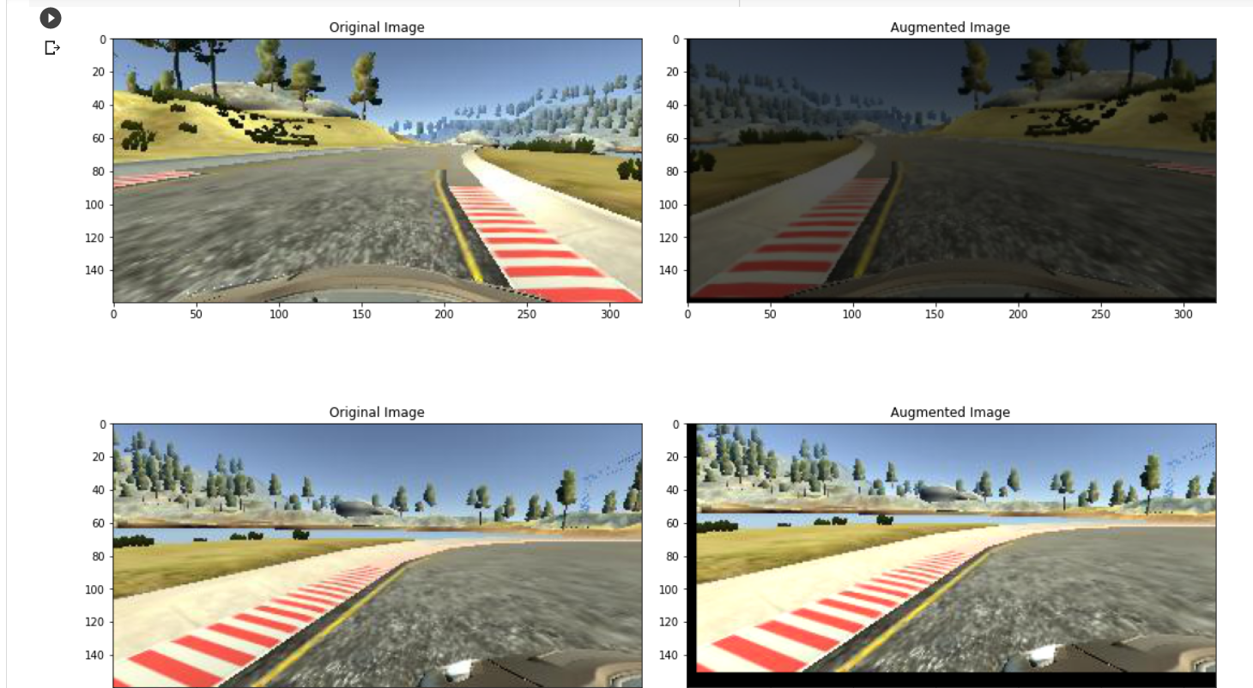

Slide 10
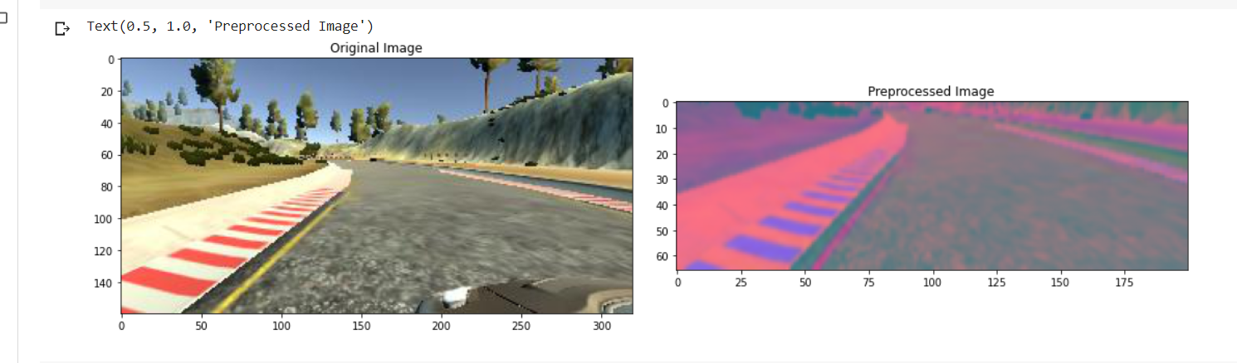
Setting up CNN Model

Slide 11
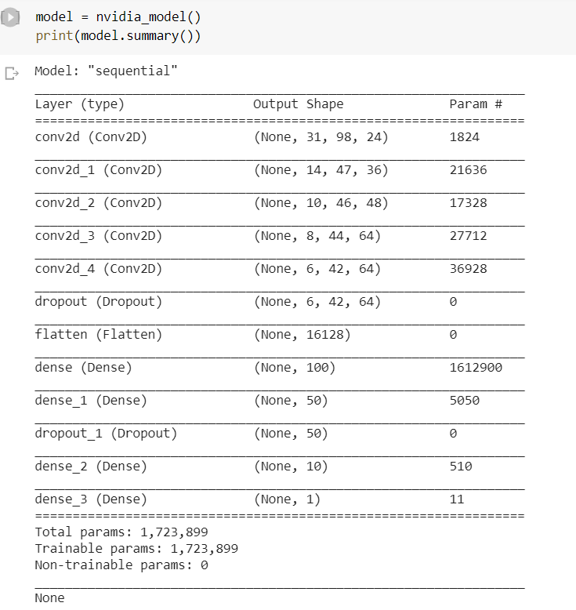

Slide 12
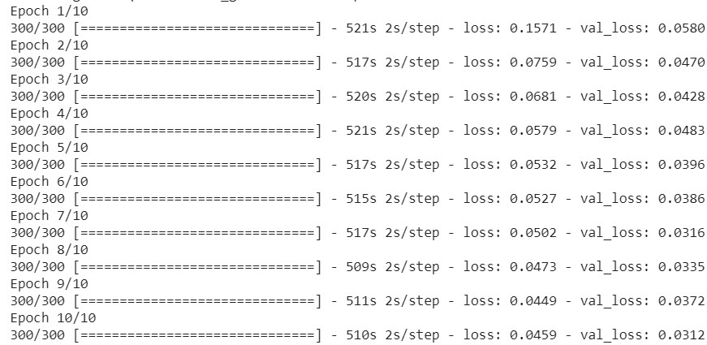

Slide 13
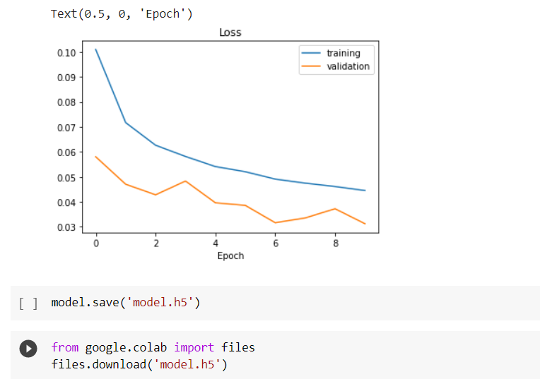

Slide 14
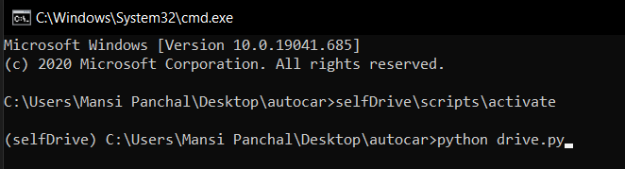

Slide 15
